Slide 1


Spring 1 Beliefs and Meaning Christianity/ Salvation KEY QUESTION – Is anything ever eternal? LEARNING OBJECTIVE - We are learning to evaluate different beliefs about eternity and to understand the Christian perspective on this.

Slide 2
Lesson 4 – Investigation
WALT - I can make links between different Christian beliefs and their views on whether anything is ever eternal.
For eternal life they need to believe in God, do their best to follow the Ten Commandments and the 2 great commandments, and ask for forgiveness when they need it (sin). They believe Jesus made forgiveness possible by his crucifixion. How is this similar or different to what you believe?
https://www.bbc.co.uk/bitesize/clips/z687tfr

Slide 3
The 10 commandments
https://www.bbc.co.uk/bitesize/clips/z687tfr

Slide 4
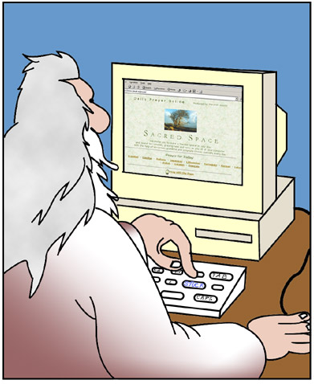

Jesus taught that there were TWO greatest commandments of all…
Part 4: The Greatest Commandments
LOVE YOUR NEIGHBOUR
LOVE GOD

Slide 5
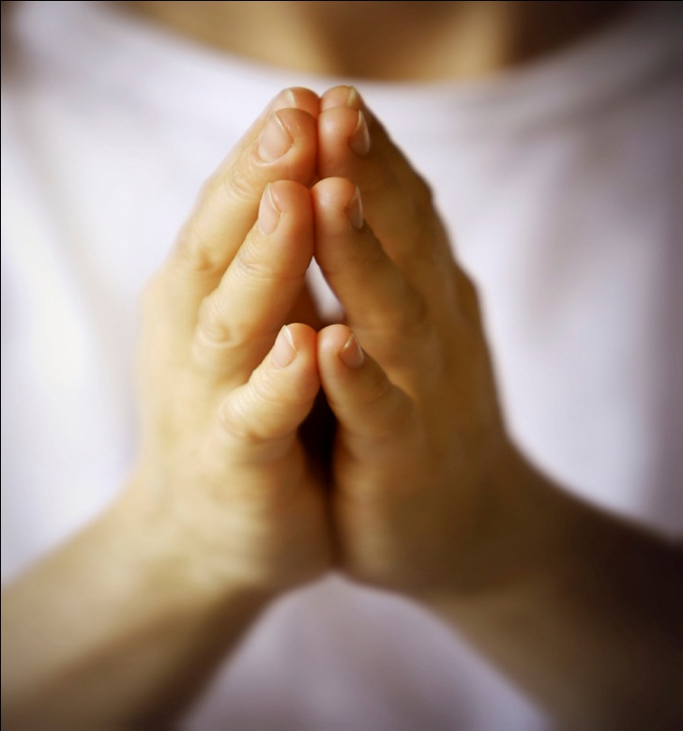

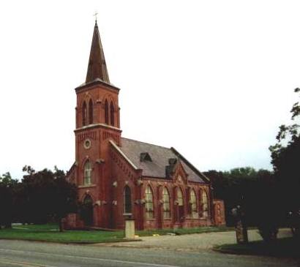
Part 4: The Greatest Commandments
Christians should Love God.
They should show this through action and belief. Christians can show their love to God by…
(How is this similar or different to other religions?)
Prayer
Sacraments
Going to Church

Slide 6
Part 4: The Greatest Commandments
Showing your love for God is important for FOUR reasons
It is repayment for Jesus’ sacrifice
Jesus said it was one of the greatest commandments
LOVE GOD
It is the teaching of the church in the catechism
It is necessary to achieve eternal life and go to heaven

Slide 7
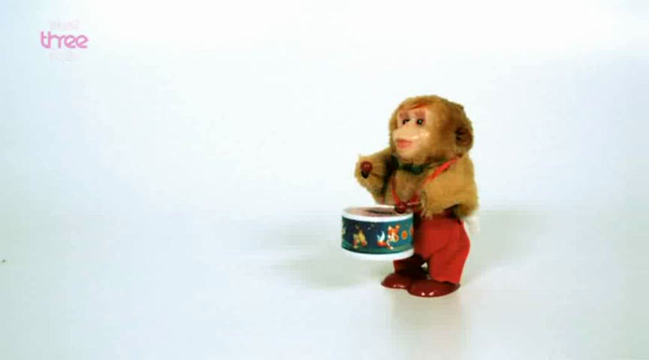
Part 4: The Greatest Commandments
A person should love their neighbour. By neighbour Jesus means ‘everybody’ around us. Loving our neighbour means that we continue the work of Jesus and his disciples today. Christians can show their love for others by:
Giving to charity
Helping the Sick
Helping in Church

Slide 8
Part 4: The Greatest Commandments
Showing our love for our neighbour is important for FOUR reasons
By loving others we are able to show our love for God
Jesus said it was one of the greatest commandments
LOVE YOUR NEIGHBOUR
By loving our neighbour we are modelling ourselves on Jesus ad continuing the work of the apostles today
It is necessary to achieve eternal life and go to heaven

Slide 9
We believe there is only one way to the Father (God) through believing in Jesus himself. He is the way, the truth and the life, so those who believe in him will not perish but have eternal life (meaning they will go to heaven)
Jesus said
“For God loved the world so much that he gave his only Son, so that everyone who believes in him may not die but have eternal life.”
‭‭John‬ ‭3:16‬ ‭GNB‬‬
This is a conversation Jesus had with his disciples when he resurrected.
““Do not be worried and upset,” Jesus told them. “Believe in God and believe also in me.
There are many rooms in my Father's house, and I am going to prepare a place for you. I would not tell you this if it were not so. And after I go and prepare a place for you, I will come back and take you to myself, so that you will be where I am. You know the way that leads to the place where I am going.” Thomas said to him, “Lord, we do not know where you are going; so how can we know the way to get there?” Jesus answered him, “I am the way, the truth, and the life; no one goes to the Father except by me. Now that you have known me,” he said to them, “you will know my Father also, and from now on you do know him and you have seen him.””
‭‭John‬ ‭14:1-7‬ ‭GNB‬‬

Slide 10
There is always forgiveness for those who ask for it, e.g. repenting. If we are truly sorry we are forgiven because Jesus died on the cross as a living sacrifice for our sins. Prior to Jesus people would have to follow the Ten Commandments as law and give blood sacrifices to express their faith e.g. slaughtering their best lamb as a sacrifice to God. But when Jesus died on the cross he became that final sacrifice that allows us all to know God and have eternal life if we choose to accept Him into our lives as Lord and Saviour.
You don’t go to heaven for doing good deeds but only by believing in Jesus. However in our love for Jesus we aim to do good as a process of having God in our lives, however we are all sinful-ever since Eve ate the apple in the garden of Eden that allowed sin into the world. The only perfect person was Jesus himself.
The way we come to faith is by ABC
Accept that we are not perfect,
Believe that Jesus is the son of God
Call on his name e.g. pray etc.

Slide 11
As a Christian, I believe that if you have faith in Jesus, then after death you will go to live with God as it states in the Bible. Unlike many religions, it is not what we do as humans that gets us to heaven, (eg how many times you go to church, good deeds), but by the grace of God. He sent his son, Jesus, to die to pay for everyone's wrong doings (sins), so anyone who truly believes this will have eternal life.
I am not sure about the other question - just that Christians believe that Jesus will return to earth again and everything will be made new again.

Slide 12
Qu: Can a non-Christian go to Heaven?
Qu: Is going to Heaven a Christian’s only motivation for doing good things?
A Humanist perspective – It is right to lead a good life even though they do not believe in life after death.
So is anything eternal? Life? Love? Relationships? Religion? God?

Slide 13
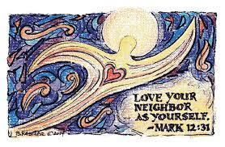


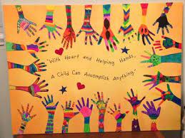

Today we are going to get creative and come up with a piece of art using the materials on the tables that represents ‘Love thy neighbour’. Here are some examples of what we could design, but feel free to think outside of the box!

